Slide 1

Note: The data and information in this document is reflective of a hypothetical situation and client. This document is to be used for KPMG Virtual Internship purposes only.
Sprocket Central Pty Ltd
Data analytics approach
[Division Name] - [Engagement Manager], [Senior Consultant], [Junior Consultant]

Slide 2
Note: The data and information in this document is reflective of a hypothetical situation and client. This document is to be used for KPMG Virtual Internship purposes only.
Agenda
Introduction
Data Exploration
Model Development
Interpretation

Slide 3
Note: The data and information in this document is reflective of a hypothetical situation and client. This document is to be used for KPMG Virtual Internship purposes only.
Introduction
New Customer List Analysis
Customer’s State
Customer’s Job
Customer’s Age
Wealth Segment
Customer’s Who Have Cars

Slide 4
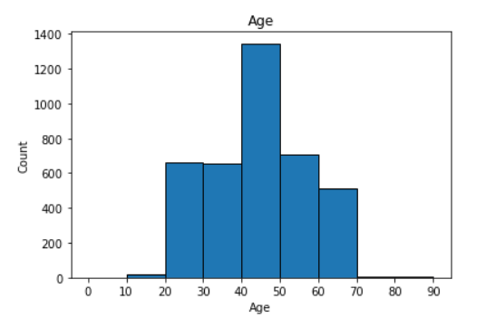
Note: The data and information in this document is reflective of a hypothetical situation and client. This document is to be used for KPMG Virtual Internship purposes only.
Data Exploration
Data Exploration Insight
We know the most buyers are in the 40-50 years old
Quite a few buyers aged 70 and over
The number of buyers aged 21-30 and 31-40 is not much different
Place any supporting images, graphs, data or extra text here.

Slide 5
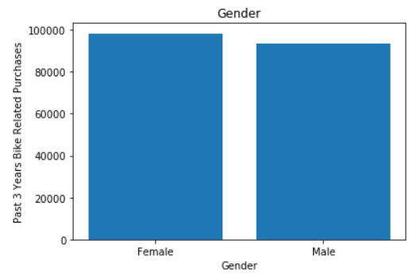
Note: The data and information in this document is reflective of a hypothetical situation and client. This document is to be used for KPMG Virtual Internship purposes only.
Model Development
Purchases Last 3 Years
We know that female customers buy more often in the last 3 years
We know that female customers are 52.12% and male customers are 47.82%
Place any supporting images, graphs, data or extra text here.

Slide 6
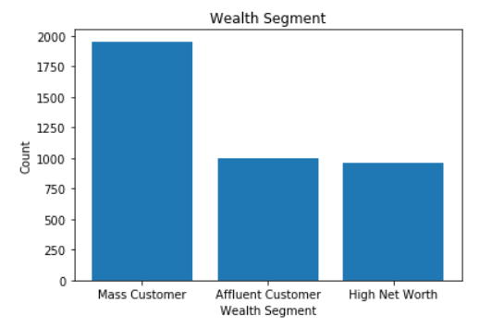
Note: The data and information in this document is reflective of a hypothetical situation and client. This document is to be used for KPMG Virtual Internship purposes only.
Interpretation
Place headline insight or information here. This should be the most important point for this slide.
We know that more buyers from mass customer
Place any supporting images, graphs, data or extra text here.

Slide 7
Note: The data and information in this document is reflective of a hypothetical situation and client. This document is to be used for KPMG Virtual Internship purposes only.
Appendix

Slide 8
Note: The data and information in this document is reflective of a hypothetical situation and client. This document is to be used for KPMG Virtual Internship purposes only.
Appendix
This is an optional slide where you may place any supporting items.

